Slide 1
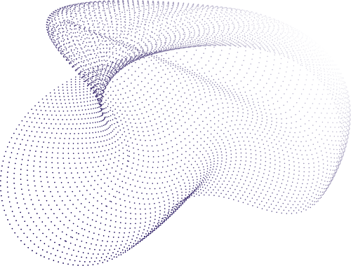

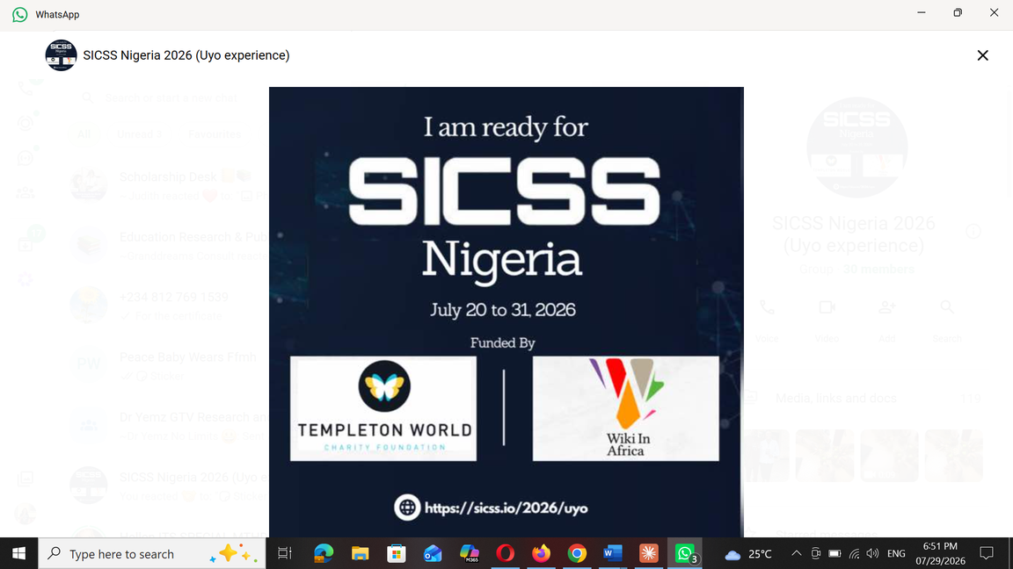

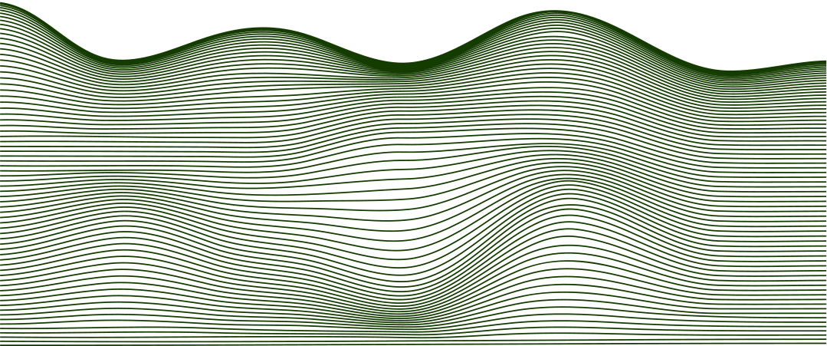
Gendered Visibility on Wikipedia: A Computational Corpus Analysis of Nigerian Women Scientists and Science Educators
Presented by Research Group 1
July 31, 2026

Slide 2



Background
& Problem
Nigeria has documented gender gaps in STEM participation, including unequal enrollment rates, persistent stereotypes, and limited engagement of women in research and teaching roles at tertiary institutions.
Wikipedia exhibits both gendered and geographic representational bias; women scientists are less likely to have biographies, and existing ones tend to be shorter and less developed than those of their male counterparts.

Slide 3
Background
& Problem
Nigerian women scientists and science educators face a compounded disadvantage at the intersection of gender and geographic under-representation on Wikipedia.
No existing study examines this critical intersection, leaving a significant gap in the digital knowledge equity literature.

Slide 4


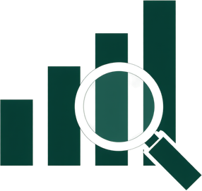

Aim & Objectives
Overall Aim: To determine how Wikipedia representation of Nigerian scientists differs by gender and to develop actionable editing guidance that addresses identified disparities in digital visibility.
Objective 1: Build a Wikipedia corpus of Nigerian women scientists and educators, benchmarked against an independent external roster (OpenAlex, ORCID, university directories).
Objective 2: Analyze gender as a predictor for Wikipedia presence and article development, controlling for professional characteristics via logistic regression and matched comparison groups.
Objective 3 & 4: Apply corpus linguistic techniques (collocation, keyness) to identify framing differences by gender; translate findings into recommendations for Wikipedia editing initiatives targeting Nigerian women.

Slide 5


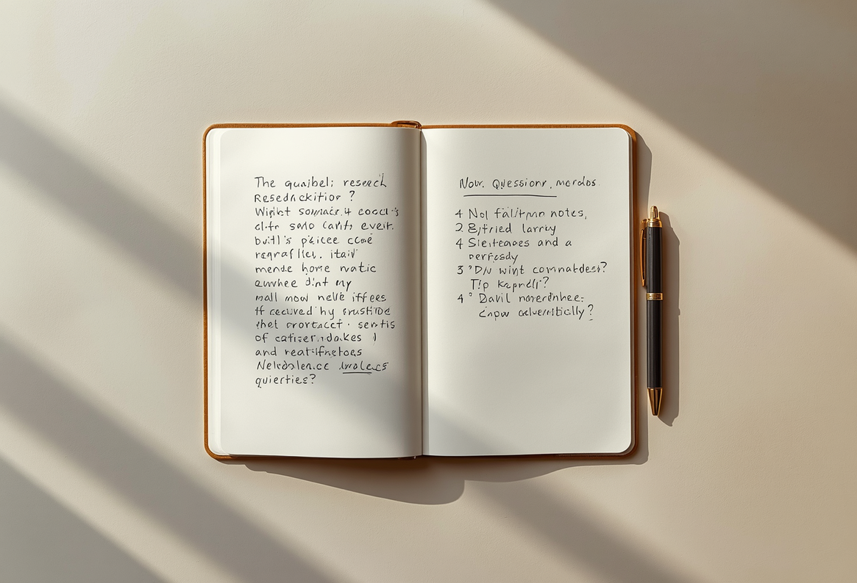
Research
Questions
  Among Nigerian scientists/science educators with equivalent professional standing, does gender predict the presence and development of a Wikipedia biography?
  2. What linguistic patterns, collocations, keywords, and framing devices distinguish the discursive construction of women’s scientific work from men’s, within Wikipedia biography text?
  3. What do these findings imply for Wikipedia editing targeting Nigerian women’s representation?

Slide 6
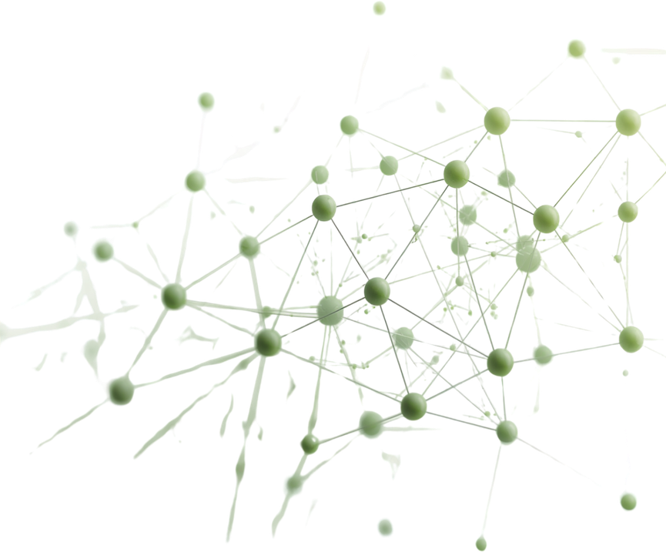
Methodology
Cross-sectional, corpus-based, mixed-methods design. External benchmark roster drawn from OpenAlex, ORCID, and Nigerian university staff directories. A matched male comparison group is constructed via Wikidata SPARQL queries controlling for discipline, rank, and career age. Three linked data layers will be used: Wikipedia article text, coverage metadata, and Wikidata/WikiProject categories.
Coverage Analysis: Logistic Regression for Presence and Length by Gender
Logistic regression models are applied to assess whether gender predicts Wikipedia presence and article length, while controlling for professional characteristics such as discipline, academic rank, and career age. Coverage gaps are quantified against the external benchmark roster.
Corpus Linguistic Analysis: Collocation, Keyness, and Framing
Collocation and keyness analyses are conducted using #LancsBox/R, with dependency parsing as a fallback for small corpora. A coding scheme captures agency and authority framing. Inter-coder reliability target: Cohen's κ ≥ .70.

Slide 7
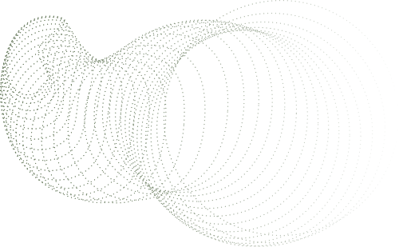
Significance
of the Study
This study makes a unique dual contribution by bridging two under-connected bodies of literature: Wikipedia representational bias research and Nigerian STEM gender equity scholarship.
• Fills a critical gap: no existing study examines the intersection of gender and geographic bias on Wikipedia for Nigerian women scientists and Science educators
• Provides empirical evidence on gendered digital visibility specific to Nigerian women scientists and science educators
• Informs Wikipedia editing initiatives, including Africa Wiki Women and Wiki Loves Women, etc with Nigeria-specific, data-driven evidence
• Supports broader efforts to advance gender equity in digital knowledge representation and open-access scholarship

Slide 8
THANK YOU

